Slide 1
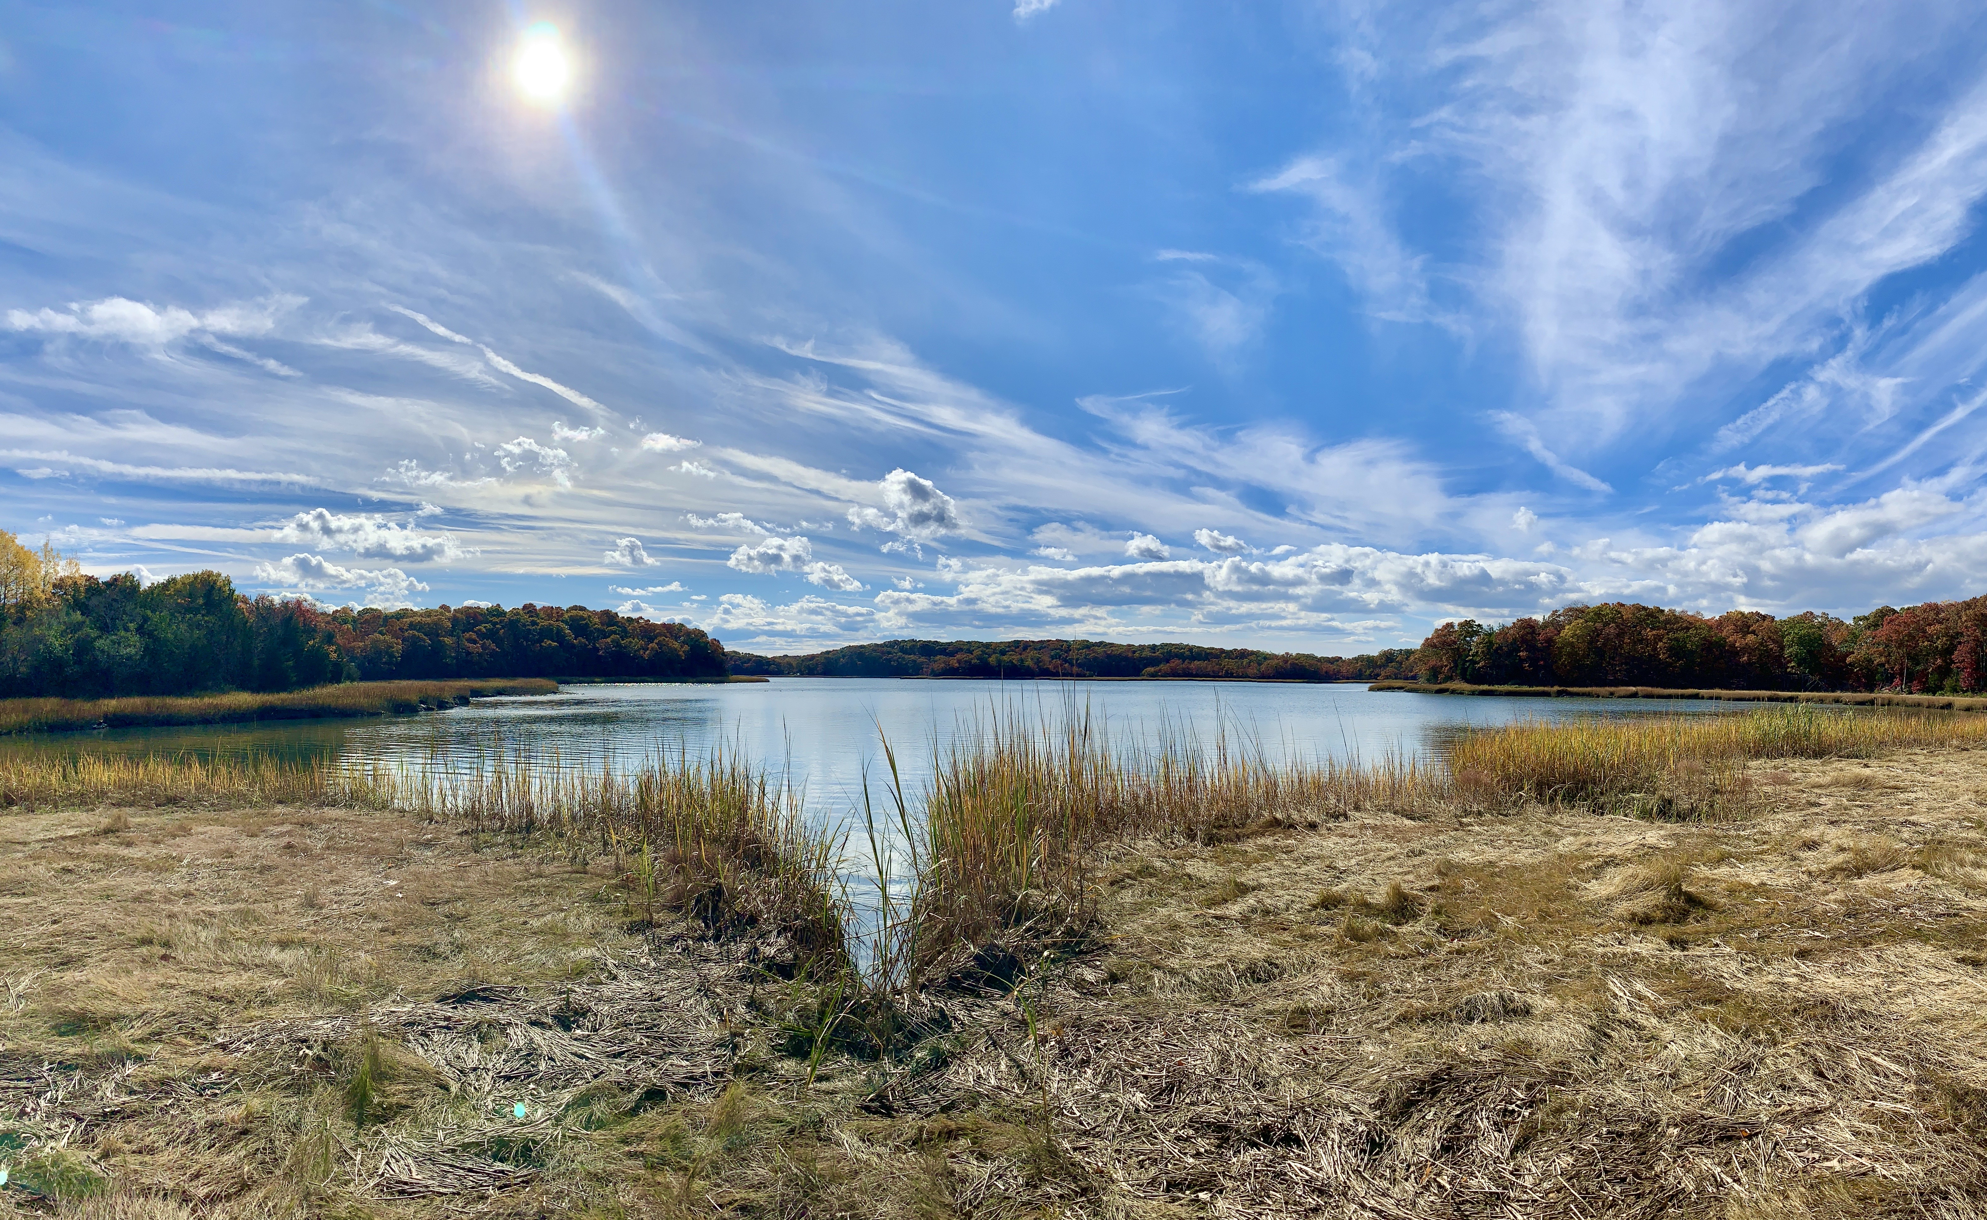





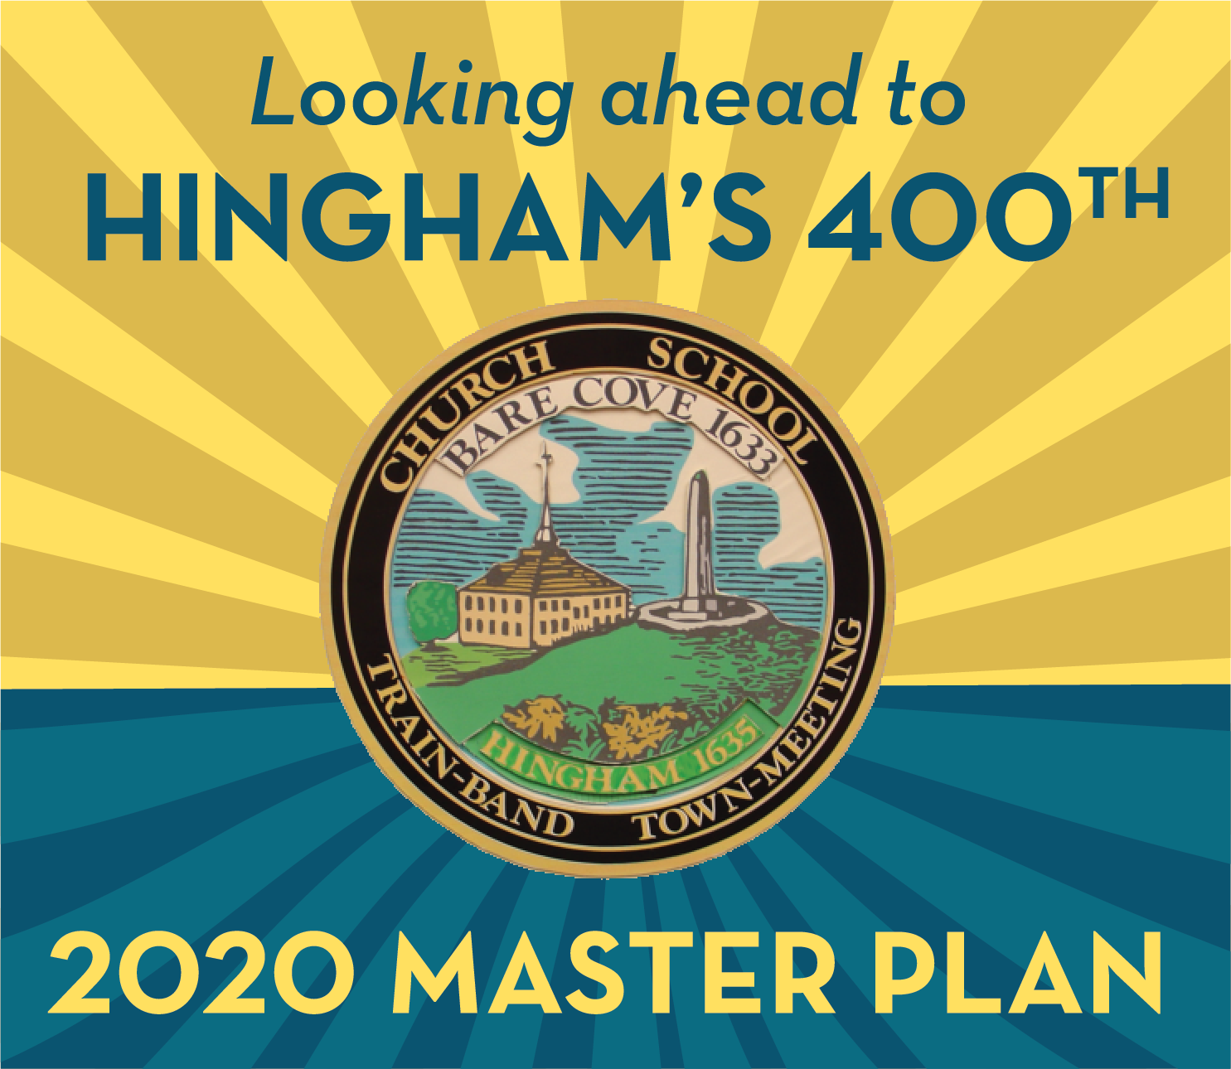
Initial Findings & Observations Hingham Master Plan Update
INTERIM REPORT
FEBRUARY 26, 2020

Slide 2
Progress Report
Vision & Goals
Inventory & Assessment Reports
Master Plan Discussion Meetings
Transportation & Sustainability / Jan. 12
Public Facilities & Housing / March 18
Natural Resources-Open Space & Historic-Cultural / March 25
Economic Development & Land Use / May 20
Additional Session (if necessary) / May 27

Slide 3

This Meeting
Initial findings & observations
Based on inventory research, core assessments, interviews, vision & goals, community survey …
Not:
Conclusions
Complete set of findings
Master plan recommendations

Slide 4








Reading the slides
Many findings relate to more than one master plan element
We’ve used Core Assessment Summary icons to identify cross-references

Slide 5
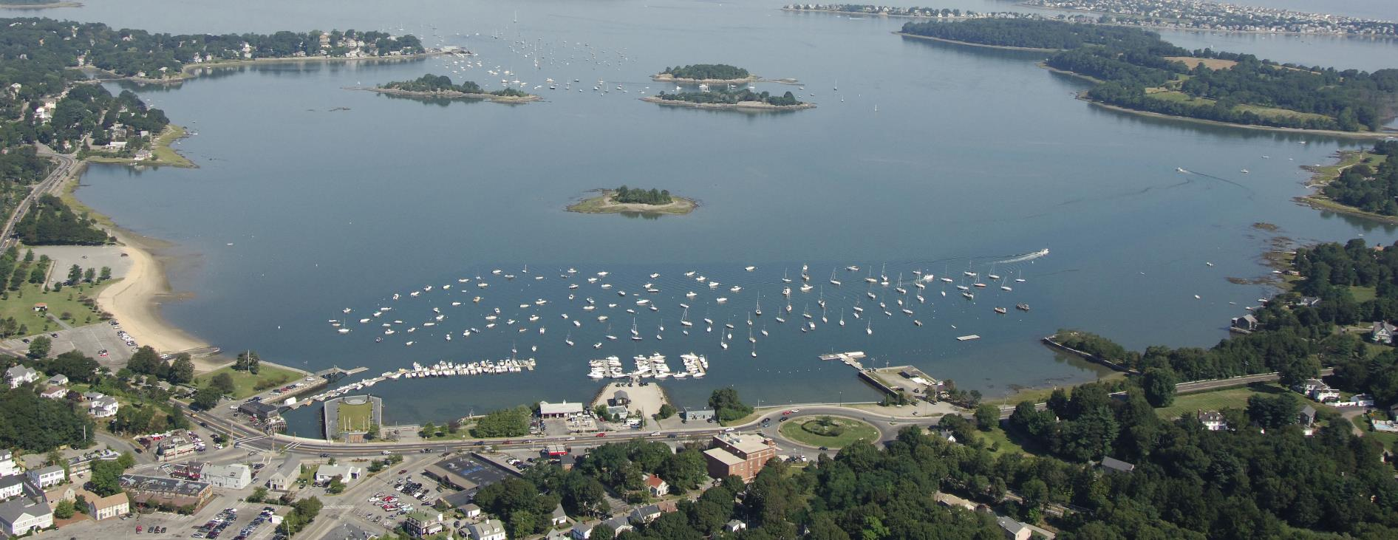
Sustainability, Water & Energy Use
HINGHAM MASTER PLAN INTERIM REPORT
FEBRUARY 26, 2020

Slide 6
Protecting natural resources from sea level rise
There are many environmental vulnerabilities related to climate change and sea-level rise (particularly storm surge and coastal erosion/shoreline change) that must be addressed during the life of the Master Plan.
Quality and availability of ground and surface water supply is at risk
Open space and forests are vulnerable to flooding, severe storms, and drought
Rising waters could leach pollutants from the transfer station
Town can aggressively seek State, Federal, and Local grants and financing to:
Identify additional sources of water supply and emergency water distribution
Pursue projects that improve tidal flow from Hingham Harbor
Pursue pilot green resilience projects around Beal Cove to absorb more flood waters/sea level rise, such as marsh expansion or living shorelines

Slide 7
Protecting infrastructure from sea level rise
There are many infrastructure resources vulnerable to climate change and sea-level rise (particularly storm surge and coastal erosion/shoreline change) that must be addressed during the life of the Master Plan.
Sewer pump stations vulnerable to inland/coastal flooding
Foster Elementary School vulnerable to flooding
Many roadways and rail routes important for emergency access and evacuation are vulnerable to flooding, such as Rte. 3A, G.W.Blvd, Rockland St., and MBTA
Town can aggressively seek State, Federal, and Local grants and financing to:
Implement resiliency improvements to sewer pump stations
Develop an emergency student relocation plan for Foster Elementary and make long term plans to replace the building
Raise roadway levels and implement existing disaster mitigation plans

Slide 8
Achieving energy reduction goals
Hingham has the opportunity to lead by example in reducing energy consumption, influencing the actions of local residents and business owners.
The Hingham Energy Action Committee is actively exploring options for reaching Carbon Neutrality
Hingham has identified which of its buildings and vehicles consume the most energy and steps for reducing this energy use
Many residents and business owners already support “going green.”
Town can aggressively seek State, Federal, and Local grants and financing to:
Implement energy efficiency upgrades in all public buildings
More aggressively seek energy efficient alternatives for Town vehicles
Start an education campaign for Town employees and the public on individual behaviors that can reduce energy use

Slide 9
Expanding policies on renewable energy
Hingham is potentially dampening renewable energy use by not having explicit policies for accessory solar facilities, wind facilities, and energy storage facilities.
More home and business owners would likely install accessory solar energy facilities if the Town had explicit policies and processes for installation
Energy storage facilities and wind energy facilities are not mentioned in the current bylaws and are therefore prohibited
Opportunities:
Develop zoning bylaw changes that explicitly allow solar energy as an accessory use for most homes and businesses
Add energy storage facilities to the zoning bylaw as a standalone industrial use as well as a smaller-scale accessory use for homes and businesses
Explore options for allowing wind turbines both on land and off shore

Slide 10
Maintaining a healthy and active harbor
Hingham Harbor, and its coastal, recreational, transportation, and economic assets, is particularly vulnerable to climate change and sea level rise.
Seawalls/Piers/Oceanic Buffers are all vulnerable due to existing conditions and need for maintenance
Parks and beaches are subject to flooding and erosion
Land-based facilities supporting boating/ferry service are vulnerable to flooding
Town can aggressively seek State, Federal, and Local grants and financing to:
Increase the height of the existing seawalls and adjacent upland
Implement resiliency plans for recreational and transportation assets
Install a Tide Gauge in Hingham Harbor

Slide 11
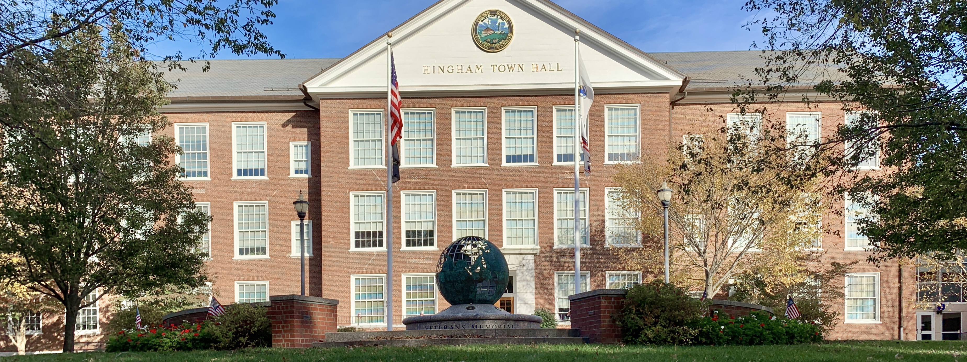
Public Facilities & Services
HINGHAM MASTER PLAN INTERIM REPORT
FEBRUARY 26, 2020

Slide 12
Condition of public facilities
The public institutions providing education need updating and upgrading in order to be state-of-the-art.
Many people move to Hingham for the schools
Foster School is expected to experience significant increase in flooding
The role of the library is increasingly that of a community center, but doesn’t have the space for programming
Opportunities:
Relocate Foster School out of flood zone
Update schools with new technology and state of the art pedagogical spaces (e.g. STEAM, maker spaces, etc.)
Support the Library in its plans to expand space, programming, parking, etc.

Slide 13
Meeting the needs of older adults
The increase in the number of older adults and the changing expectations regarding aging will have implications regarding the need to provide services.
Hingham has highest percentage of people over 65 in South Shore
Between 2000-2010, residents 65+ increased by 55% (compared to 16% statewide)
Space and parking are inadequate at the Senior Center
Baby boomers have different expectations regarding aging
Only 14 percent of residents living in town use the Senior Center
Opportunities:
Re-brand Senior Center
Create a Community Center for all ages
Increase transportation and health, wellness and fitness services and programming
Continue co-programming

Slide 14
Public safety services & facilities
Old/outdated facilities, changing demographics, and significant increase in development have resulted in need to upgrade public safety facilities.
All three fire stations built in 1941
Response times in South Hingham are worse than in the rest of town
Police and Fire Departments: increase in calls associated with aging population
Police Department space inadequate
Opportunities:
Renovate fire stations
Consider relocating fire station
Plan for possible future need for a fourth fire station
Consider new police facility

Slide 15
Future of public utilities
Public utilities including sewer, water, and electricity need to be maintained and expanded to support increasing development.
Sewer: 40% of Town in two sewer districts
Water: 95% of homes connected to public water system
Electricity: HMLP will need to increase capacity
Opportunities:
Develop South Hingham Sewer District
Explore possibility of constructing a Wastewater Treatment Plant
Increase awareness regarding need to reduce water consumption
Identify additional sources of water
Support HML to expand capacity (add transmission line)

Slide 16
Capital planning
As the Town has grown, so has the need to formalize and make the process of capital planning and deferred maintenance more systematic.
Long-term capital projects come out of separate committees
Some Town staff report a lack of clarity regarding decision-making
Opportunities:
Develop criteria for prioritizing capital improvement projects
Hire full-time Facilities Manager
Form a Consolidated Facilities Committee
Prepare a Town-wide Facilities Master Plan

Slide 17
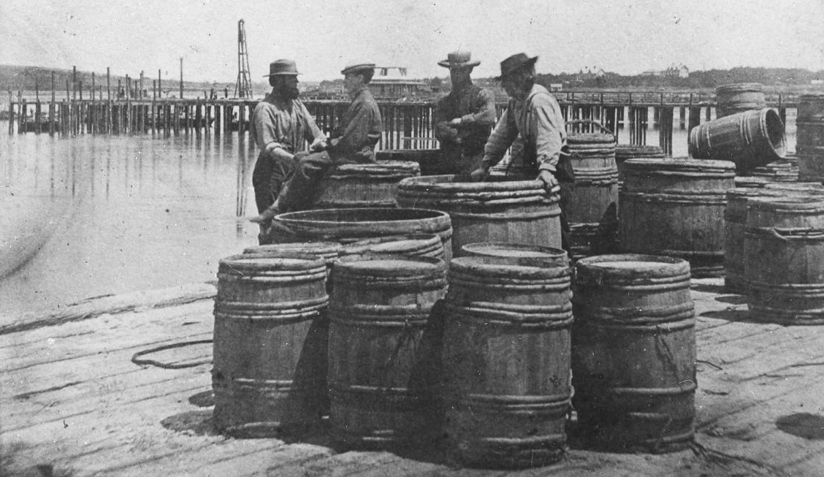
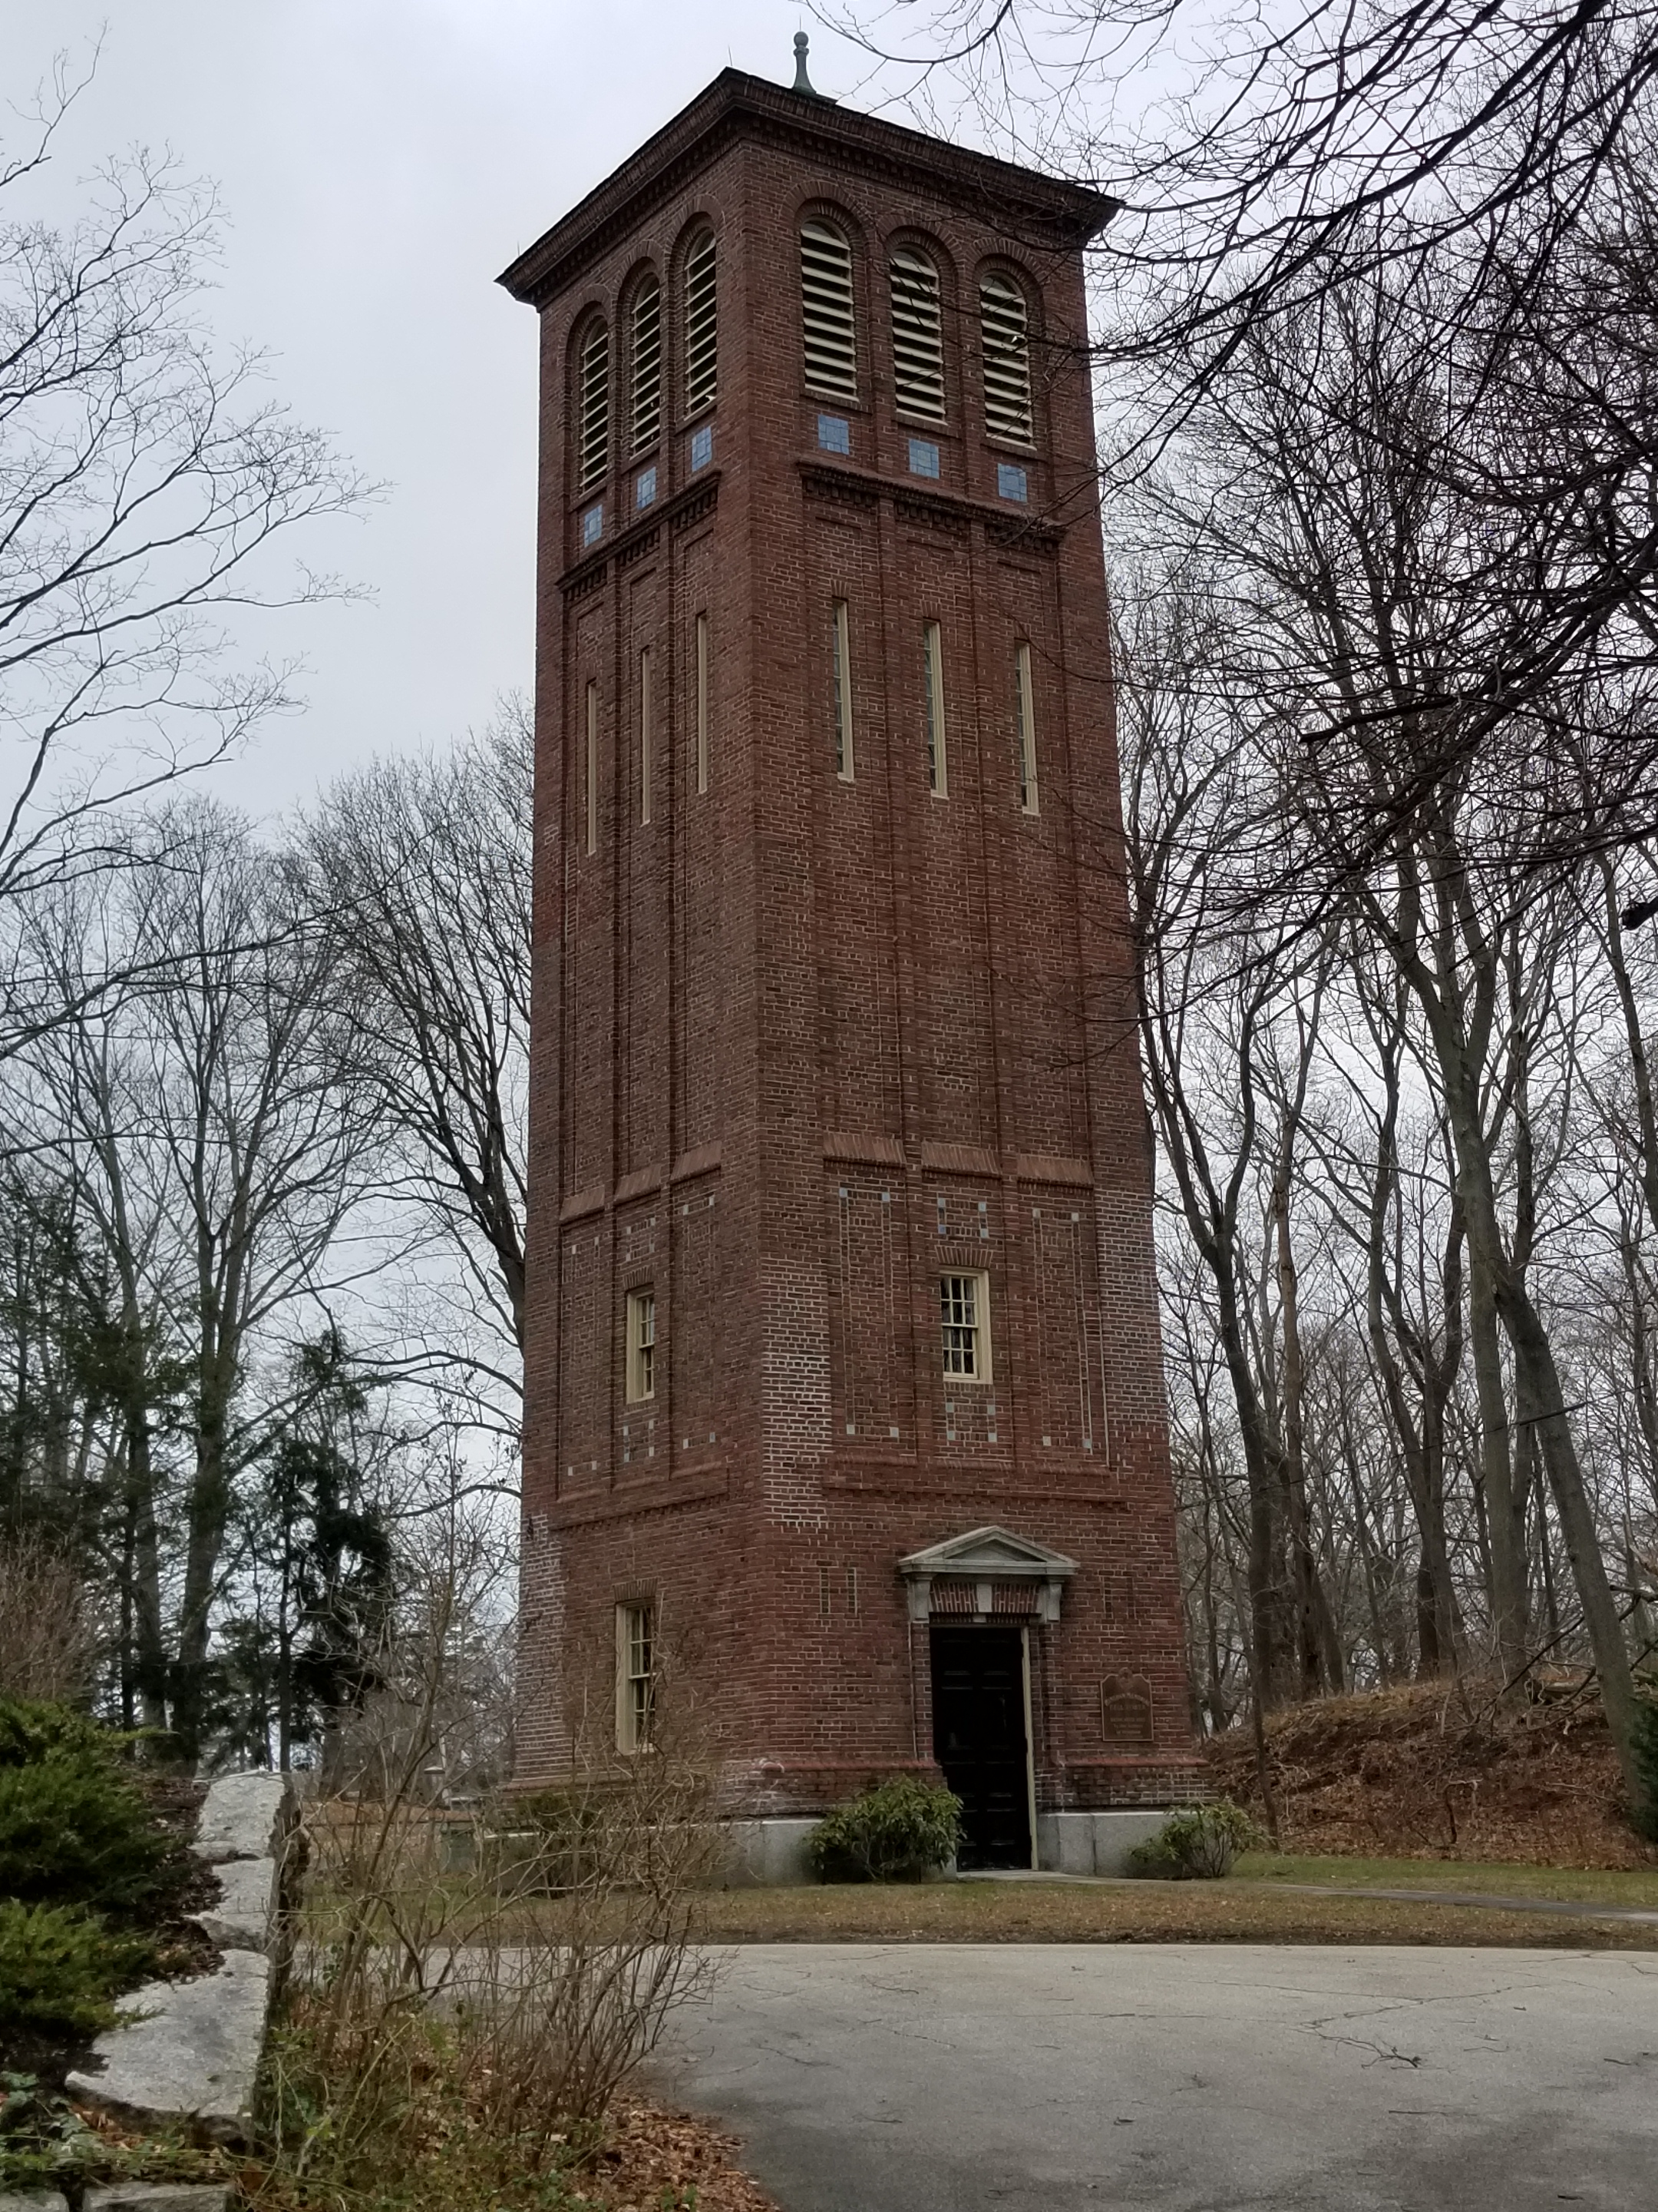
Historic and Cultural Resources
HINGHAM MASTER PLAN INTERIM REPORT
FEBRUARY 26, 2020

Slide 18
Protection of historic buildings, landscapes, roads and scenic vistas
Hingham has established seven Local Historic Districts with approximately 700 homes, commercial and civic structures and historic landscapes, and the town’s Scenic Roads Bylaw has designated eight routes, yet many historic resources remained threatened.
The Local Historic Districts cover just 10% of historic buildings and the Scenic Roads Bylaw has protected a small fraction of roads.
Opportunities:
Create additional Local Historic Districts to protect a greater portion of historic resources
Provide education programs to new homeowners about the value of preserving their historic property, and involve children in this effort
Amend the existing Scenic Roads Bylaw to include more stringent criteria relating to removal of historic stone walls, trees and other natural and manmade features
Designate additional roads through the Scenic Roads Bylaw

Slide 19
Loss of smaller sized historic homes
Hingham has a scarcity of smaller sized historic homes desired by residents who want to remain in Hingham, but wish to down-size
Since Hingham’s Demolition Delay Bylaw was enacted in the late 1980s, the town has lost roughly half of the buildings reviewed under the bylaw after the six-month delay is imposed.
The short six-month delay period of the Demolition Delay Bylaw has allowed property owners to simply wait out the delay and the proceed with demolition, and many smaller homes have been replaced by much larger ones.
Opportunities:
Extend the delay period to a maximum of two years
Provide financial incentives to developers who restore historic properties as affordable housing
Provide financial incentives to first-time owners of small historic homes to restore, rather than replace their properties

Slide 20
Incompatible changes to neighborhoods
Current zoning, specifically lot coverage, allows property owners to build homes that are out of scale with their neighborhood
Existing lot coverages have resulted densities that conflict with traditional neighborhood patterns, altering historic character.
Opportunities:
Amend the existing zoning bylaw with redefined lot coverages that more accurately reflect traditional patterns
Create overlay districts in areas where historic homes remain to preserve historic lot coverages and traditional patterns

Slide 21
Entrances to Hingham
Gateways into Hingham from the north, east and south lack clear definition and do not clearly convey to visitors a sense of arrival.
Entrances from neighboring towns lack consistent signage, plantings, lighting and other landscape amenities that reflect the character of Hingham and welcome visitors to town.
Opportunities:
Work with neighboring towns of Weymouth, Norwell and Cohasset when opportunity arises, to upgrade shared intersections (for example, at Queen Anne’s Corner)
Develop and implement a signage and landscape plan that can be applied to all major entrances

Slide 22
Preservation of town records
Hingham lacks a comprehensive catalogue of historic town records, as well as a facility and system for storing the records.
Town records are not currently maintained by one entity and each department has developed its own approach to saving, storing and preserving records.
Neither the Library nor the Town Hall has the capacity to adequately and safely store records.
Opportunities:
Create a system to archive records, both manually and electronically
Build a facility for storing records
Hire a professional archivist to catalogue and maintain records

Slide 23
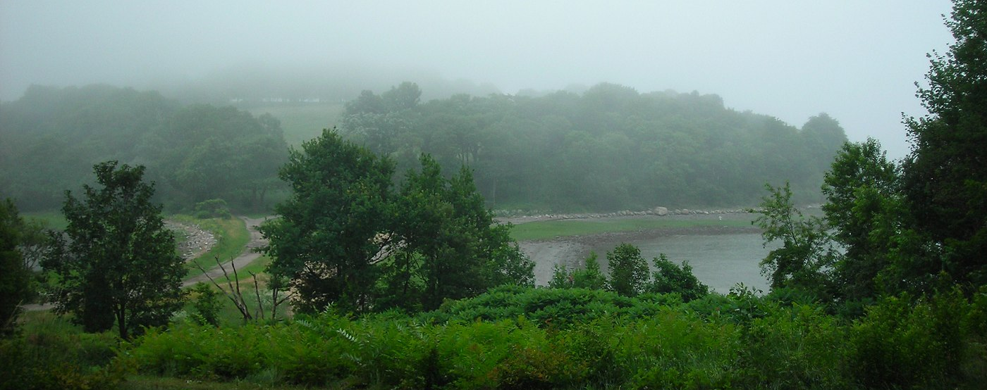
Natural, Open Space and Recreation Resources
HINGHAM MASTER PLAN INTERIM REPORT
FEBRUARY 26, 2020

Slide 24
Protection of water quality
Residents and key stakeholders have expressed concern about water quality and quantity, including the need to conserve water in a more proactive way
Groundwater, recharged by Accord Brook, supplies much of the town with drinking water and while the town has taken steps to protect the Accord Brook Watershed, supply is not unlimited. The town has not placed restrictions on watering of lawns.
Opportunities:
Update and strengthen regulations associated with the existing watershed protection district
Regulate the watering of lawns to promote water conservation

Slide 25
Management of existing protected open space
The cost of purchasing open space in Hingham is high and management of open space is an additional cost.
Hingham contains more than 4,000 of protected open space through ownership and easement held by the town and land trusts.
A total of nine entities of town government, including departments, trustees and partnerships, manage the 2,800 acres of town-owned open space and recreation land.
The degree to which this open space is managed varies depending on the resources of the owner.
Opportunities:
Require that funds to manage open space acquisitions accompany all future gifts of open space lands
Explore alternative approaches to land management, such as forming friends’ groups and/or open space cooperatives
Consolidate and streamline management of town-owned open space and recreation land

Slide 26
Open space and recreation site connections
Many of Hingham’s open space parcels and recreation areas are disconnected from one another, making it difficult for users to move between multiple sites on a single recreation outing. Connections can also serve as wildlife corridors.
A recently completed comprehensive trails study confirmed the lack of linkages, and identified many opportunities for making connections.
Opportunities:
Devote more resources to making these connections
Develop a signage program to better identify open spaces and the connections between them

Slide 27
Recreation field needs
The town will need to balance support for expanded, upgraded and additional recreation fields with the need for more and improved public services, including a library and new senior center.
Hingham recently commissioned a recreation fields assessment to better understand existing conditions and forecast long term needs. This study is in progress.
Opportunities:
Weigh the recommendations of this assessment with other priorities for improved public facilities

Slide 28
Neighborhood playgrounds
Hingham maintains several school and neighborhood playgrounds, each with a shelf-life of 20 to 30 years. The cost to the town to maintain these is high and ongoing.
Between 2013 and 2019, the Community Preservation Committee funded nearly $250,000 to upgrade existing playgrounds and construct new playgrounds at four sites.
The town operates just one fully ADA-compliant playground.
Opportunities:
Explore sustainable approaches to constructing playgrounds and playground equipment
Consider replacing traditional playgrounds with nature-based playgrounds
Enlist the efforts of volunteers to raise funds for playground equipment

Slide 29
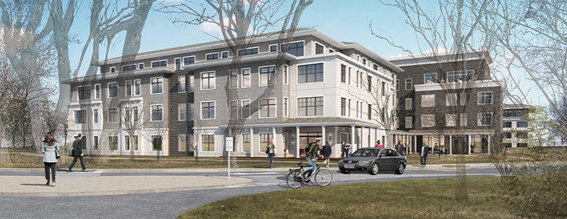
Housing & Demographics
HINGHAM MASTER PLAN INTERIM REPORT
FEBRUARY 26, 2020

Slide 30
Affordable housing inventory
Hingham has done more than many South Shore communities to provide affordable housing.
Hingham exceeds the 10 percent statutory minimum under Chapter 40B; 11.37%
Examples of local initiatives: Lincoln School and 80 Beal Street
Over $2 million from CPA for housing, 2003-2018
Opportunities:
Take a selective approach to future affordable housing proposals
Consider a comprehensive approach to inclusionary zoning
Focus on housing needs of specific populations, e.g., older adults, people with disabilities, local workforce, other needs identified in Hingham Housing Plan

Slide 31
The tear-down market
There is market demand and market opportunity for turning existing residential properties in Hingham into higher-value assets, mainly through teardowns.
1/2017 to 10/2019: 54 single-family teardowns
Also an uptick in single-family to two-family home conversions: 14 in 5 years
High land-value ratios - homes built ca. 1929-1974 - 25 percent of single-family home inventory
Opportunities:
Revisit lot coverage ratios in the residential districts
Large-house review bylaw comparable to Wellesley’s
Targeted affordable housing buydowns

Slide 32
High housing cost burdens
Despite Hingham’s efforts to exceed the 10 percent minimum under Chapter 40B, there are many unaffordably housed residents in the town, especially renters.
Hingham has the highest median gross rent as % of household income – 44.9% - of all the surrounding towns, Plymouth County, and state. In some parts of town, it exceeds 50 percent.
Most cost burdened renters have incomes below $50,000; about half of all renters.
Opportunities:
Focus future affordable housing initiatives on deeper subsidies for lower-income rental units
Explore options for CPA-funded rental assistance (e.g., Chatham model)

Slide 33
Hingham Affordable Housing Trust
Hingham has CPA and Hingham Affordable Housing Trust. With funding and staff support, the HAHT could become an even stronger player in affordable housing: as developer, investor, housing services provider, and advocate.
About 9.2 percent of CPA committed to community housing.
Many towns systematically commit 10+ percent.
Short-term rental occupancy tax could help to fund HAHT initiatives
Opportunities:
Adopt 6 percent local tax rate for short-term rentals and commit to the HAHT
Provide General Fund appropriations to the HAHT
Establish inclusionary zoning, give developer “fee in lieu” payments to HAHT

Slide 34
Inclusionary zoning
Hingham’s zoning has some affordable housing provisions for affordable housing (Multifamily, Flexible Development), but no comprehensive approach to inclusionary zoning (IZ).
IZ usually applies to any development over a certain size.
Town-wide or district-based, with requirements customized to each district.
About one-third of Massachusetts cities/towns have IZ; varied results.
Opportunities:
Assemble working group to explore feasibility and design options for IZ.
Consider options for “fee in lieu” for small projects, with funding for HAHT.
Increase opportunities to develop multifamily housing and tie IZ to density bonuses.

Slide 35
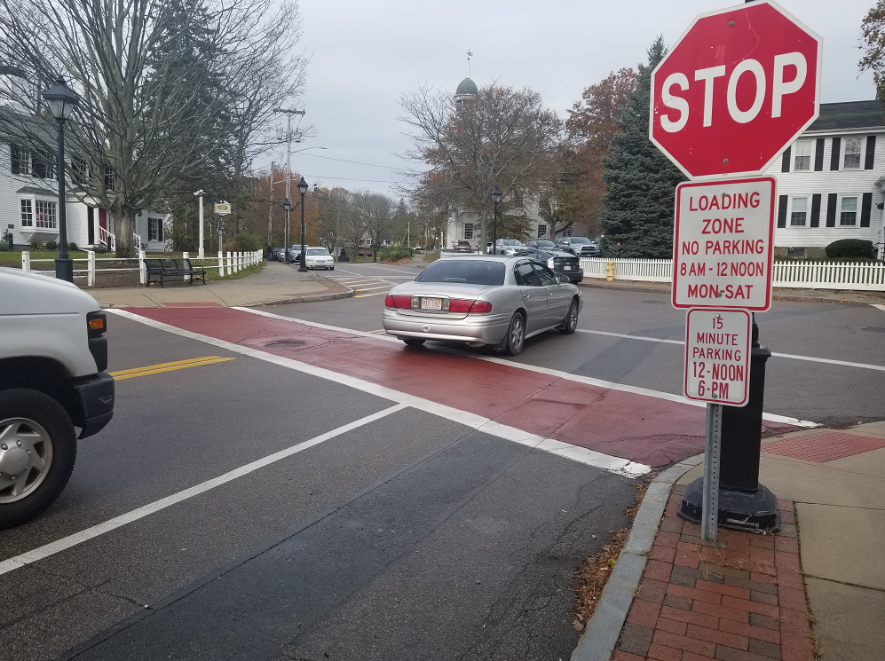
Transportation
HINGHAM MASTER PLAN INTERIM REPORT
FEBRUARY 26, 2020

Slide 36
Parking
Finding available Parking in Hingham Square can be challenging.
Merchant’s Parking Lot is 96% occupied on weekdays
Little or no enforcement of on-street parking
Employees parking all day limit turnover
Parking may spillover to neighborhood streets
Opportunities:
Manage parking and increase turnover through increased enforcement
Revisit parking limits for on-street spaces
Identify long-term parking areas for employees
Identify opportunities for shared-parking
Consider eliminating minimum parking requirements for developments

Slide 37
Traffic congestion and safety
Traffic Congestion and Safety is an issue on several roadways.
High crash rates at locations on Route 3A (Kilby St, Summer St Rotary), Route 3 and Derby Street
High traffic volume growth on Route 3A, Route 53, and Derby Street
New development planned in South Hingham will increase traffic volumes
Speeding
Opportunities:
Complete planned Route 3A Road Diet Project
Complete MassDOT Derby Street Corridor Project
Monitor and enforce speeding
Identify potential improvements for intersections (signals) and roadways

Slide 38
Pedestrian and bicycle safety and connectivity
It is difficult to walk/bike between The Square, Harbor, Neighborhoods and Destinations.
Pedestrians and bicyclists do not feel comfortable crossing Route 3A
Several roadways have no sidewalks and bicycle facilities (Martins Lane)
Some sidewalks need repair and/or are too narrow
There are no dedicated on-street bike lanes (sharrows only)
Pedestrian signals and accessible ramps are inadequate at some intersections
Opportunities:
Complete ongoing study to evaluate sidewalks, signage and crosswalks
Develop a Pedestrian and Bicycle Plan to prioritize improvements
Identify Safe Routes to School project eligible for MassDOT funding

Slide 39
Transit
Bus and shuttle service may not be adequate for residents.
MBTA Bus service has been reduced. Bus #220 does not stop within Shipyard and no bus service to commuter rail stations
Parking demand is increasing at the Shipyard, availability may become an issue
Parking lots at commuter rail stations and Town Hall are near capacity on a regular basis
Demand for the Senior Center Medical Van and Shuttle Van exceeds capacity. No weekend service
Opportunities:
Coordinate with MBTA to improve service and connections
Evaluate need and potential ridership demand for shuttle bus service
Identify funding opportunities for first mile/last mile service and a pilot shuttle bus program

Slide 40
Transportation Demand Management (TDM)
New development planned for South Hingham will increase traffic in this area. TDM strategies could be employed to reduce employee single-occupant auto travel.
Traffic added from new developments will exacerbate delay and congestion in the area and neighborhood streets
Traffic, Safety, and Infrastructure Improvement Fund with South Hingham Development Overlay District. No TDM requirements.
Opportunities:
Use funds to mitigate development-related transportation impacts within the Overlay District
Develop TDM regulations and thresholds for new development

Slide 41
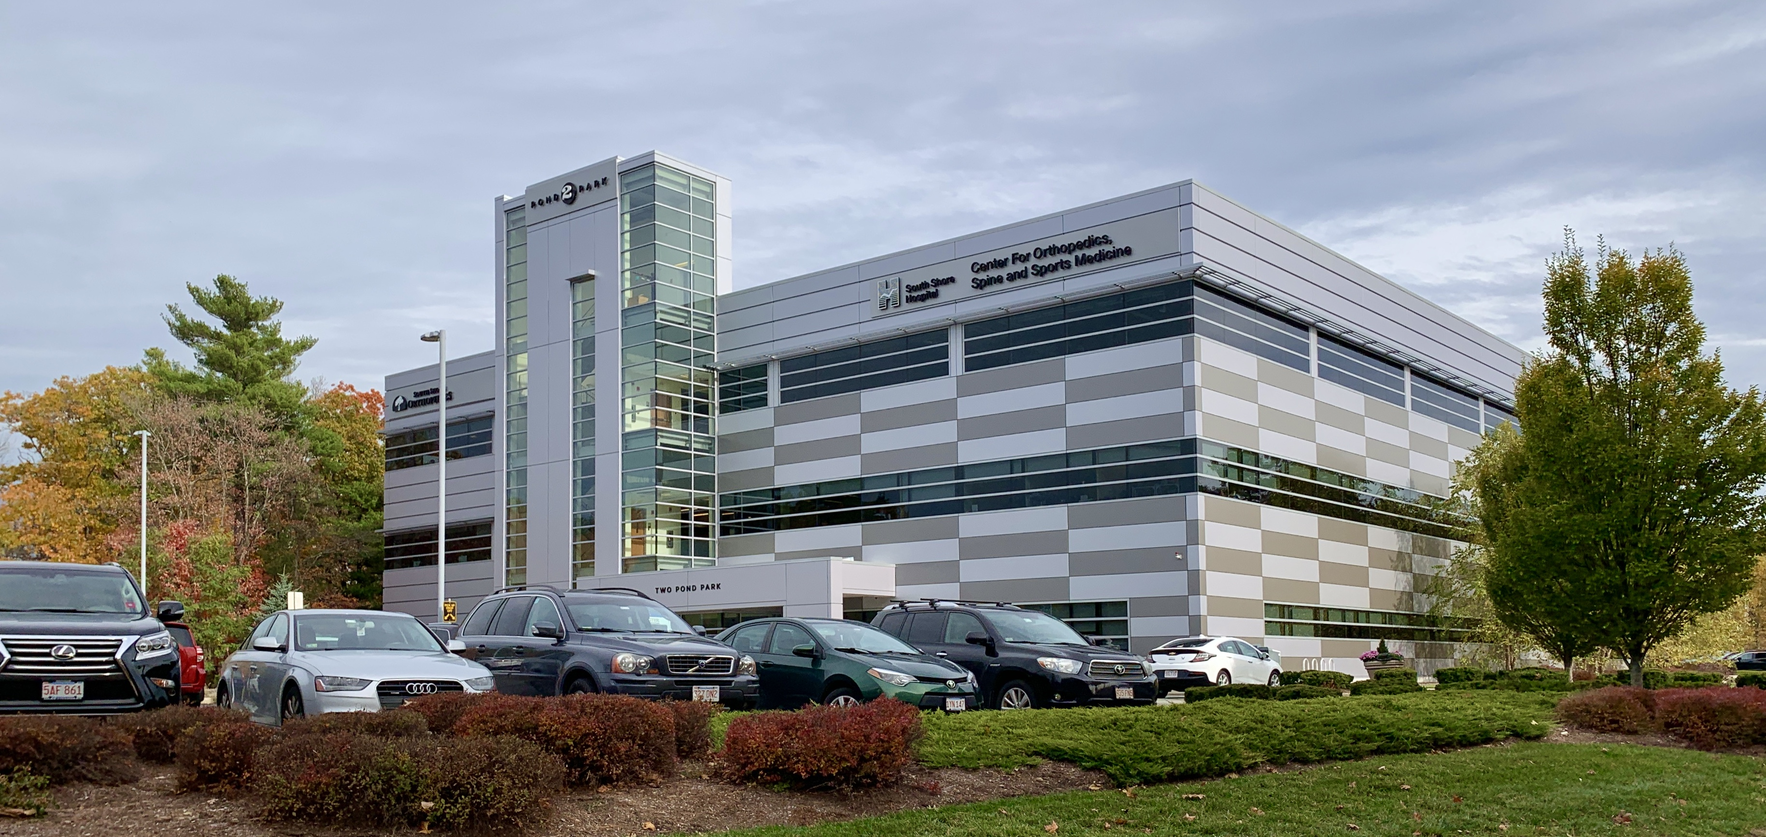
Economic Development
HINGHAM MASTER PLAN INTERIM REPORT
FEBRUARY 26, 2020

Slide 42
Labor force and employment
There is a less-than-optimal “match” between Hingham’s highly educated labor force, the make-up of its employment base, and opportunities to work locally.
Hingham’s strongest industries are construction, retail, finance/ insurance, arts and entertainment, management of companies and enterprises, and to a lesser extent, professional services. All have location quotients over 1.50.
Most Hingham residents work in information, finance and real estate, prof. services.
Most local job growth happening in lower-wage employment.
Imbalance between jobs in Hingham and employment/wage needs of households.
Residents with the highest wage/salary earnings commute by public transportation.
Opportunities:
Tailor economic development strategies to align jobs and labor force.
Facilitate collaborative workspaces for self-employed and home-based workers.

Slide 43
South Hingham
Hingham has potential for economic growth in South Hingham. Local planning has been done, and one of the Planning Board’s master plan goals is to “encourage high-quality commercial and mixed-use development in South Hingham and the Hingham Shipyard.” It seems that little has happened since South Hingham Study Group final report in 2017.
The need for sewer in South Hingham has not been resolved. Public safety challenges exist, too.
Master planning has been done to reposition South Shore Park as a mixed-use office-industrial center with housing, retail and services.
There is opposition to more development in South Hingham.
Opportunities:
Recognize South Hingham as critical direction needed for this Master Plan update.
Work with South Shore Chamber to facilitate consensus and determine a path forward for infrastructure, transportation, and regulatory reform for South Hingham.
Collaborate with neighboring Rockland to achieve mutual benefits.

Slide 44
Permit process
When it comes to the permitting process, Hingham is not regarded as a “business-friendly” town.
Complaints: slow and unpredictable process, Town has high but unrealistic expectations, boards listen too much to residents.
Zoning is sometimes convoluted/difficult to follow and understand/poorly written.
Opportunities:
Review division of responsibilities/shared or overlapping jurisdiction
Focus group with developers, attorneys, and engineers/architects to understand their experiences with Hingham’s approval process – a permitting “self-assessment” process
Survey “best practices” in permitting
Consider options to streamline or consolidate permitting
Review administrative rules and regulations, applications, and procedures from an applicant’s perspective
Update the Zoning Bylaw

Slide 45
Downtown Hingham
As one commenter said at a core assessment meeting, “Downtown Hingham is nice, but it isn’t extraordinary.”
Attractive buildings, historic charm, walkable design, but –
Limited/fragmented connectivity with the waterfront
Perceived shortage of parking
Conflicts between traffic speeds and pedestrian safety
High rents and ability of small, traditional downtown establishments to survive
How much housing should be encouraged or even allowed?
Opportunities:
Downtown/Hingham Harbor Master Plan (with MAPC)
Resist temptation to over-regulate commercial space in mixed-use buildings
Parking management plan for the downtown area

Slide 46
Long-term trends in retail development
Hingham has two significant retail centers with national brands – Derby Street and the Shipyard – but retail is under pressure everywhere, due in part to overstored markets and in part to online shopping.
Re-invention of Hanover Mall: example of regional challenges
Other changes around Hingham: potential Chapter 40R at Queen Anne’s Corner and planning in Weymouth to catalyze investment along Bridge Street.
Opportunities:
Be alert to the transformation of retail centers to mixed-use developments and their potential impact on Hingham’s economy
Redevelopment, intensification of use, and mix of uses in South Hingham and further concentration of housing near the Shipyard
Consider options for form-based code over traditional zoning, especially in South Hingham, as a strategy to facilitate market-driven development

Slide 47
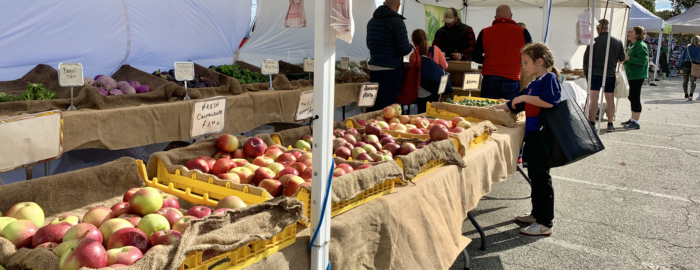
Questions?
HINGHAM MASTER PLAN INTERIM REPORT
FEBRUARY 26, 2020

