Slide 1
AGENDA
Board Reorganization
CPC Grant Eligibility
2025-2026 CPC Schedule
Administrative Items
Approval of Minutes
Items Not Anticipated Within 48 Hours of the Meeting

Slide 2
Board Reorganization
Eryn Kelley, Vice Chair, Select Board Appointment
Ruth Bennett, Housing Authority Representative
Elizabeth Dings, Historical Commission Representative
Vicki Donlan, Recreation Department
David Ellison, Select Board Appointment
Crystal Kelly, Planning Board Representative
Nancy MacDonald, Town Moderator Appointment
Kirsten Moore, Town Moderator Appointment
Philip Edmundson, Conservation Commission Representative

Slide 3
2024-2025 Grant Review
Hingham Recreation Commission
Carlson Pickleball Courts
Hingham Historic Society
Old Ordinary Campus Improvements
Hingham Affordable Housing Trust
Net Proceeds
Opportunity Fund

Slide 4
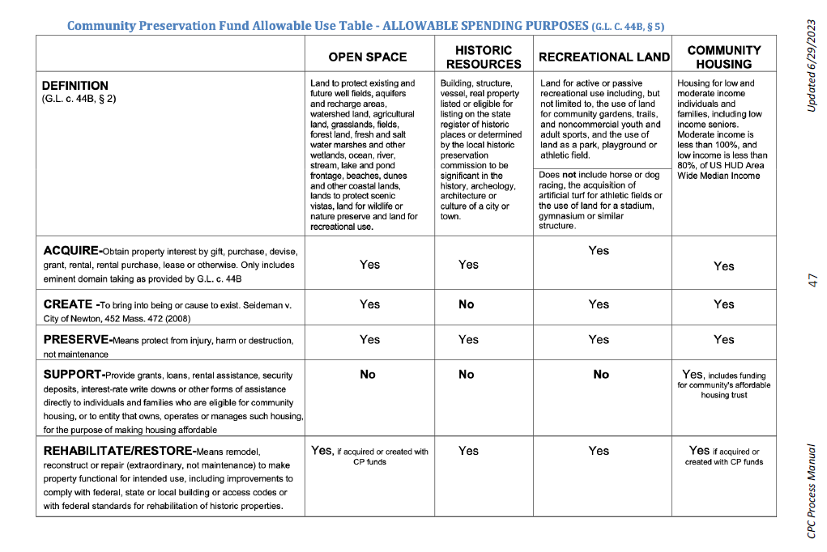
Community Preservation Fund Allowable Use Table
ALLOWABLE SPENDING PURPOSES (G.L.C. 44B, § 5)

Slide 5
Application Preparation
Planning Stage: Consider possible needs and expenses
Realistic Budget
Who will be doing the work
Aspects to consider
Materials, Permits, and Insurance
Consulting, Advisory and Legal Services
Coordination with Town Departments
Maintaining Project Records
Tracking Project Finances,
Contractor and Site Worker: License, Certification, and Insurance
Reminder: Any effort or costs associated with the application process are not reimbursable by the Town or the CPC.

Slide 6
Application Documentation
Final Application Form–Due October 7, 2025
Applicant
Project Name
Project Description
Project Total Cost and CPA Request
Additional Funding (if applicable)
Budget (Outlined) Non Profits should include current financial statement
Timing- for approved projects, CPA funds will be available July 1st and work is expected to be completed with tin two(2) years of that date.
Note Any Time Sensitivity
Contact Person

Slide 7
Application Documentation continued
Project Scope
Key Steps for Implementation
List of Stakeholders and their respective needs or resources
Professional Oversight and Ongoing Project Management Responsibility
Anticipated Maintenance
Benefits to the Town of Hingham
Criteria to Determine Success of Implementation
Any Pertinent Additional Information
Control of Site
Further Needs and Actions
Email your completed application to cpc@Hingham-ma.gov no later than 11:59 PM October 7, 2025. No late applications will be accepted.

Slide 8
Additional Attachments
Additional Attachments
Itemized quotes from three (3) vendors in the project field (provide date of preparation)
Maps, photographs, diagrams or other visual aids
Assessors map showing location of the Project
Documentation of any existing restrictions
Photographs of the site and any existing structures located on the site
Architectural Plans and specifications (new construction/renovation), maps, rendering, etc.
Historic structures report, existing conditions report
Names and addresses of project architects, contractors, consultants
Documentation explaining why your application may not follow certain Town or CPC guidelines
Certificate of Non-Collusion
If your project involves land acquisition, Land Acquisition Form
Any other information useful to the Committee to consider the project.

Slide 9
2025-2026 Schedule
2025
July 1 | New Round of Funding Begins; see Preliminary Eligibility Application
September 9 | Preliminary Eligibility Application Due
September 10 | CPC Meeting - Board Reorganization, Grant Eligibility Review
September 17 | CPC Meeting - Review Preliminary Eligibility Applications
October 7 | Final Application Due (only if Prelim. Application accepted)
October 22 | CPC Meeting - review Final Applications
October 25 | Site Visits
November 4 & 5 | CPC Meeting - Project Presentations (2nd date if necessary)
December 10 | CPC Meeting - General administration and discussion
2026
January 7 | CPC Meeting - Final Project Presentations
January 14 | CPC Final Vote
April 27 | Town Meeting

Slide 10
Administrative Items
Conflict of Interest Training and Acknowledgement
New Member onboarding
Approval of Minutes
Matters not anticipated with n 48 hours of the meeting

