Slide 1

Hingham Housing Plan
Community Forum
December 4, 2019

Slide 2
What is affordable housing?
Different definitions of affordable housing…
HUD definition of affordable is spending no more than 30% of gross income on housing costs
40B definition – “A” affordable units include:
Available to households earning at or below 80% of area median income
Permanent units subsidized or approved by a subsidizing agency
Deed restricted
Affirmatively marketed
Household Size (No. of Persons) | 2019 Income Limits | 2018 Income Limits
1 | $62,450 | $56,800
2 | $71,400 | $64,900
3 | $80,300 | $73,000
4 | $89,200 | $81,100
5 | $96,350 | $87,600
6 | $103,500 | $94,100

Slide 3
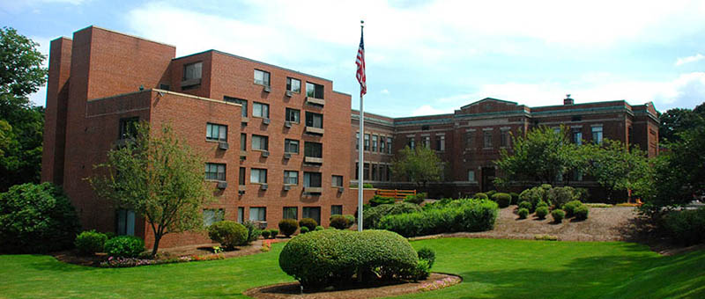
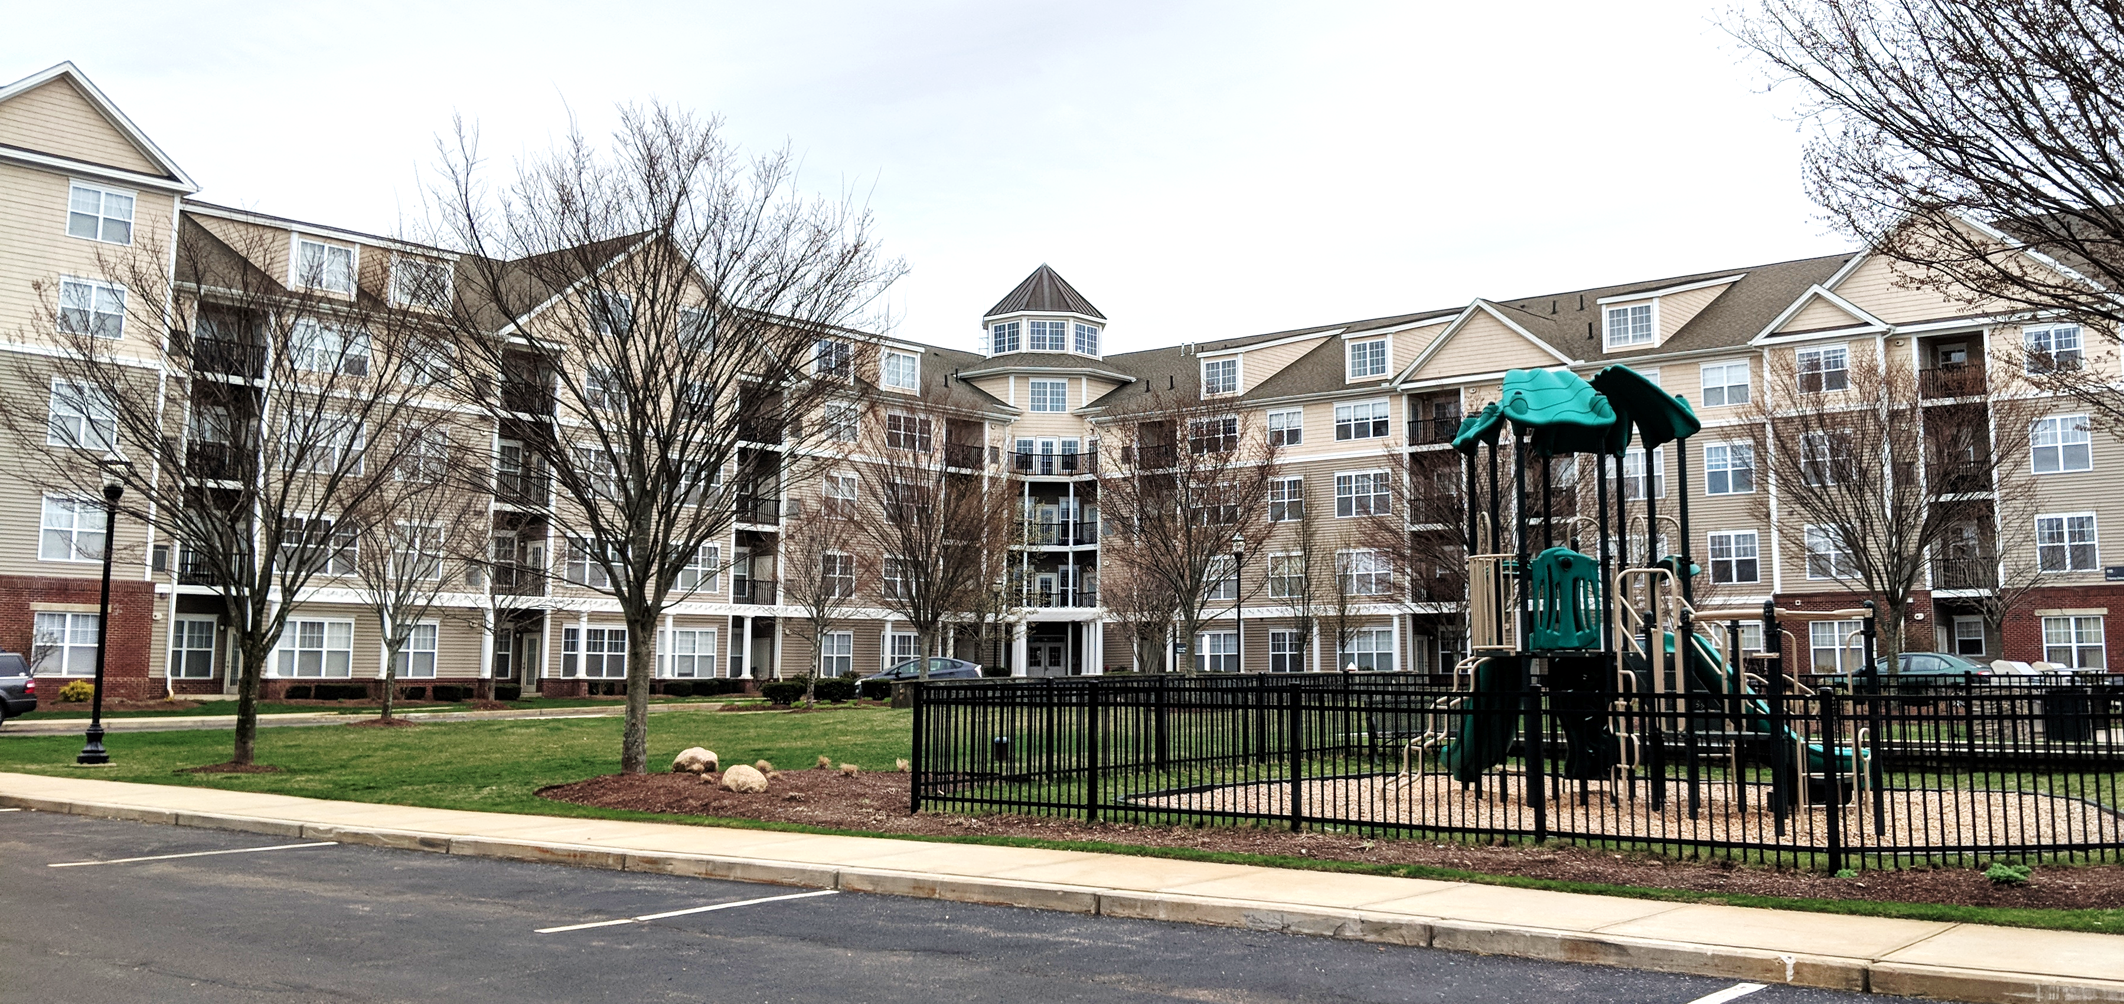
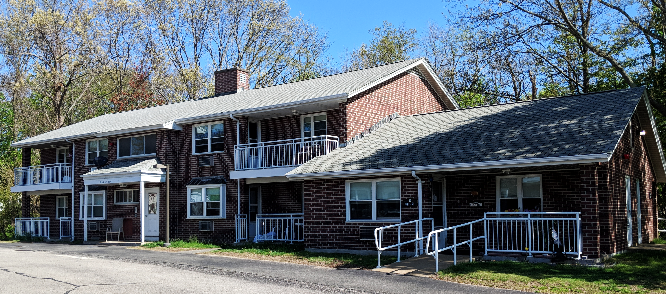
What housing is “Affordable” in Hingham?
Subsidized Housing Inventory (SHI) Details
1,005 units or uncontested 11.37% of 8,841 year-round housing units, are currently considered eligible by the state for inclusion on the SHI
349 or 35% of SHI units are actually affordable
121 units over the 10% state affordability goal
30+ units above the 10% level following 2020 census based on projected housing growth
Lincoln School
Avalon Hingham Shipyard I
Thaxter Park

Slide 4
Key Trends
Demographic
Aging Population
Projected Decline in Children, Middle Age
Economic
Relatively High Median Income of $125,441
Housing
High Growth and Substantial Demo/Rebuilt
Predominance of Ownership (0% Vacancy)
Growth in Smaller Households
Growing Income Disparities between Owner and Renter Households
Growth in Rental Units (8.6% Vacancy)
Notes:
Major increases in older residents – Baby Boomers and Linden Ponds
Projected declines in children and middle aged residents
Growth in smaller households including those living alone
In terms of Income, Median is relatively high at $125,441, but there are growing disparities. Median income of owners increased by 69% to $152,674 while median of renters decreased by 3% to $48,284.
High Growth Community with 918 new units built between 2010 and 2018.
Also substantial demolition/replacement activity at about 40% of new single-family home development between 2010 and 2018.
Predominance of owner-occupancy at 80% in 2017 but down from 86% in 2000 and with a net gain of 777 units.
Notable growth in rental housing units, from 14% to 20% between 2000 and 2017 with a net gain of 746 units and more underway, thus increasing housing diversity.
0% vacancy rate for ownership, 8.6% for rentals.

Slide 5
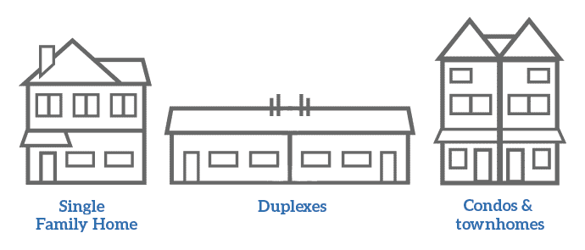
Housing Costs
Indicators of need for various income levels…
Very little affordability remaining in the private housing market
Median prices remain high for homeowners and renters
High single-family affordability gap of $270,750 for median income earning household and widening to $535,750 at the 80% AMI limit
Increasing cost burdens as 30% or 2,493 households were spending too much for their housing including 17% or 1,415 with severe cost burdens
Two-thirds of those earning at or below 80% AMI were experiencing cost burdens including 1,200 or 51.5% with severe cost burdens
$813,750
Single-Family Home
$450,000
Condominium
$2,190
Rent/Month
2019 Hingham Housing Plan
Notes:
Recognition that there are still unmet and pressing housing needs, despite reaching the 10% state affordability goal
Identify and address the wide range of housing needs based on income levels and target populations, including seniors, families, veterans, those with disabilities.

Slide 6



Existing Tools to Address Housing Needs
Hingham is committed to maintaining and increasing housing diversity and affordability…
Public-Private Partnerships to develop affordable housing
Community Preservation Act
Affordable Housing Trust; Dedicated Staff Support
Housing Choice “High Growth” Community and Capital Grant
Comprehensive Master Plan and Regional “Housing Options” Plan
Zoning for Flexible Residential, Multi-Unit Developments (Big “A”)
Zoning for Mixed Uses, Accessory Dwelling Units (Little “a”)
Tax Exemptions
2019 Hingham Housing Plan
Notes:
Examples: Partnered with Habitat for Humanity starting in the 1990s through the present time to develop single family affordable housing (Central Street, Winona Way, Whiting Street)
Most recent public-private partnership, expressed through a Development Agreement between the Selectmen and Alliance Residential Development, yielded 55 affordable rental units, pushing Hingham over an uncontested 10% on the SHI. Related public benefits include $1M for school improvements, land transfer for public park purposes, parking and traffic improvements along Beal Street.
Other partnerships developed through Local Initiative Program, in which the Selectmen supported a 40B application or otherwise assist in creating affordable housing. Examples include the Avalon developments at the Shipyard, Whiting Lane,

Slide 7
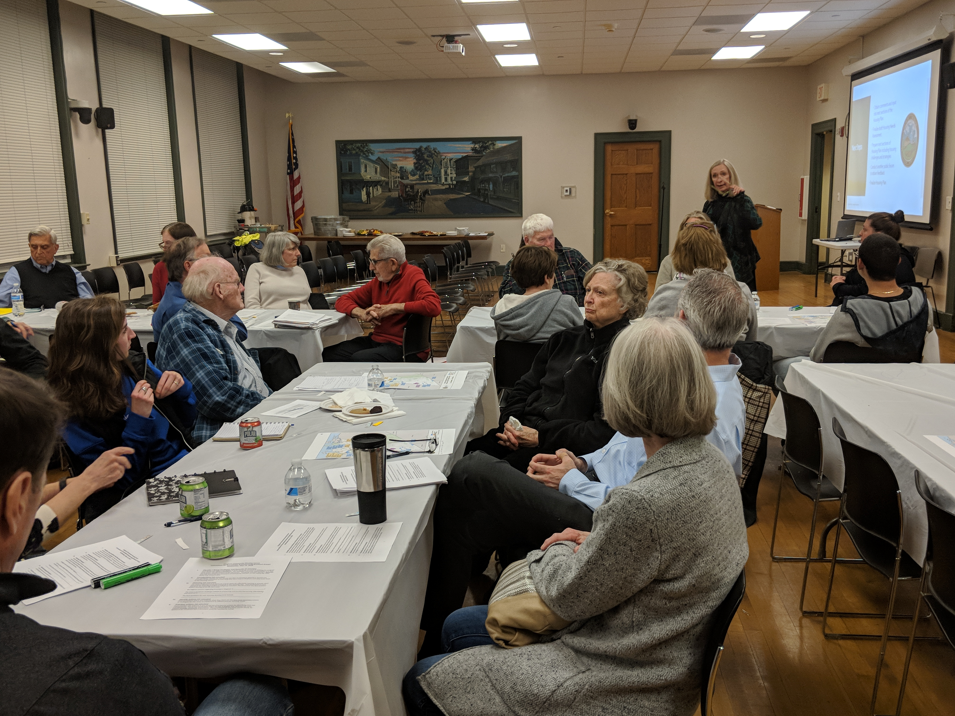
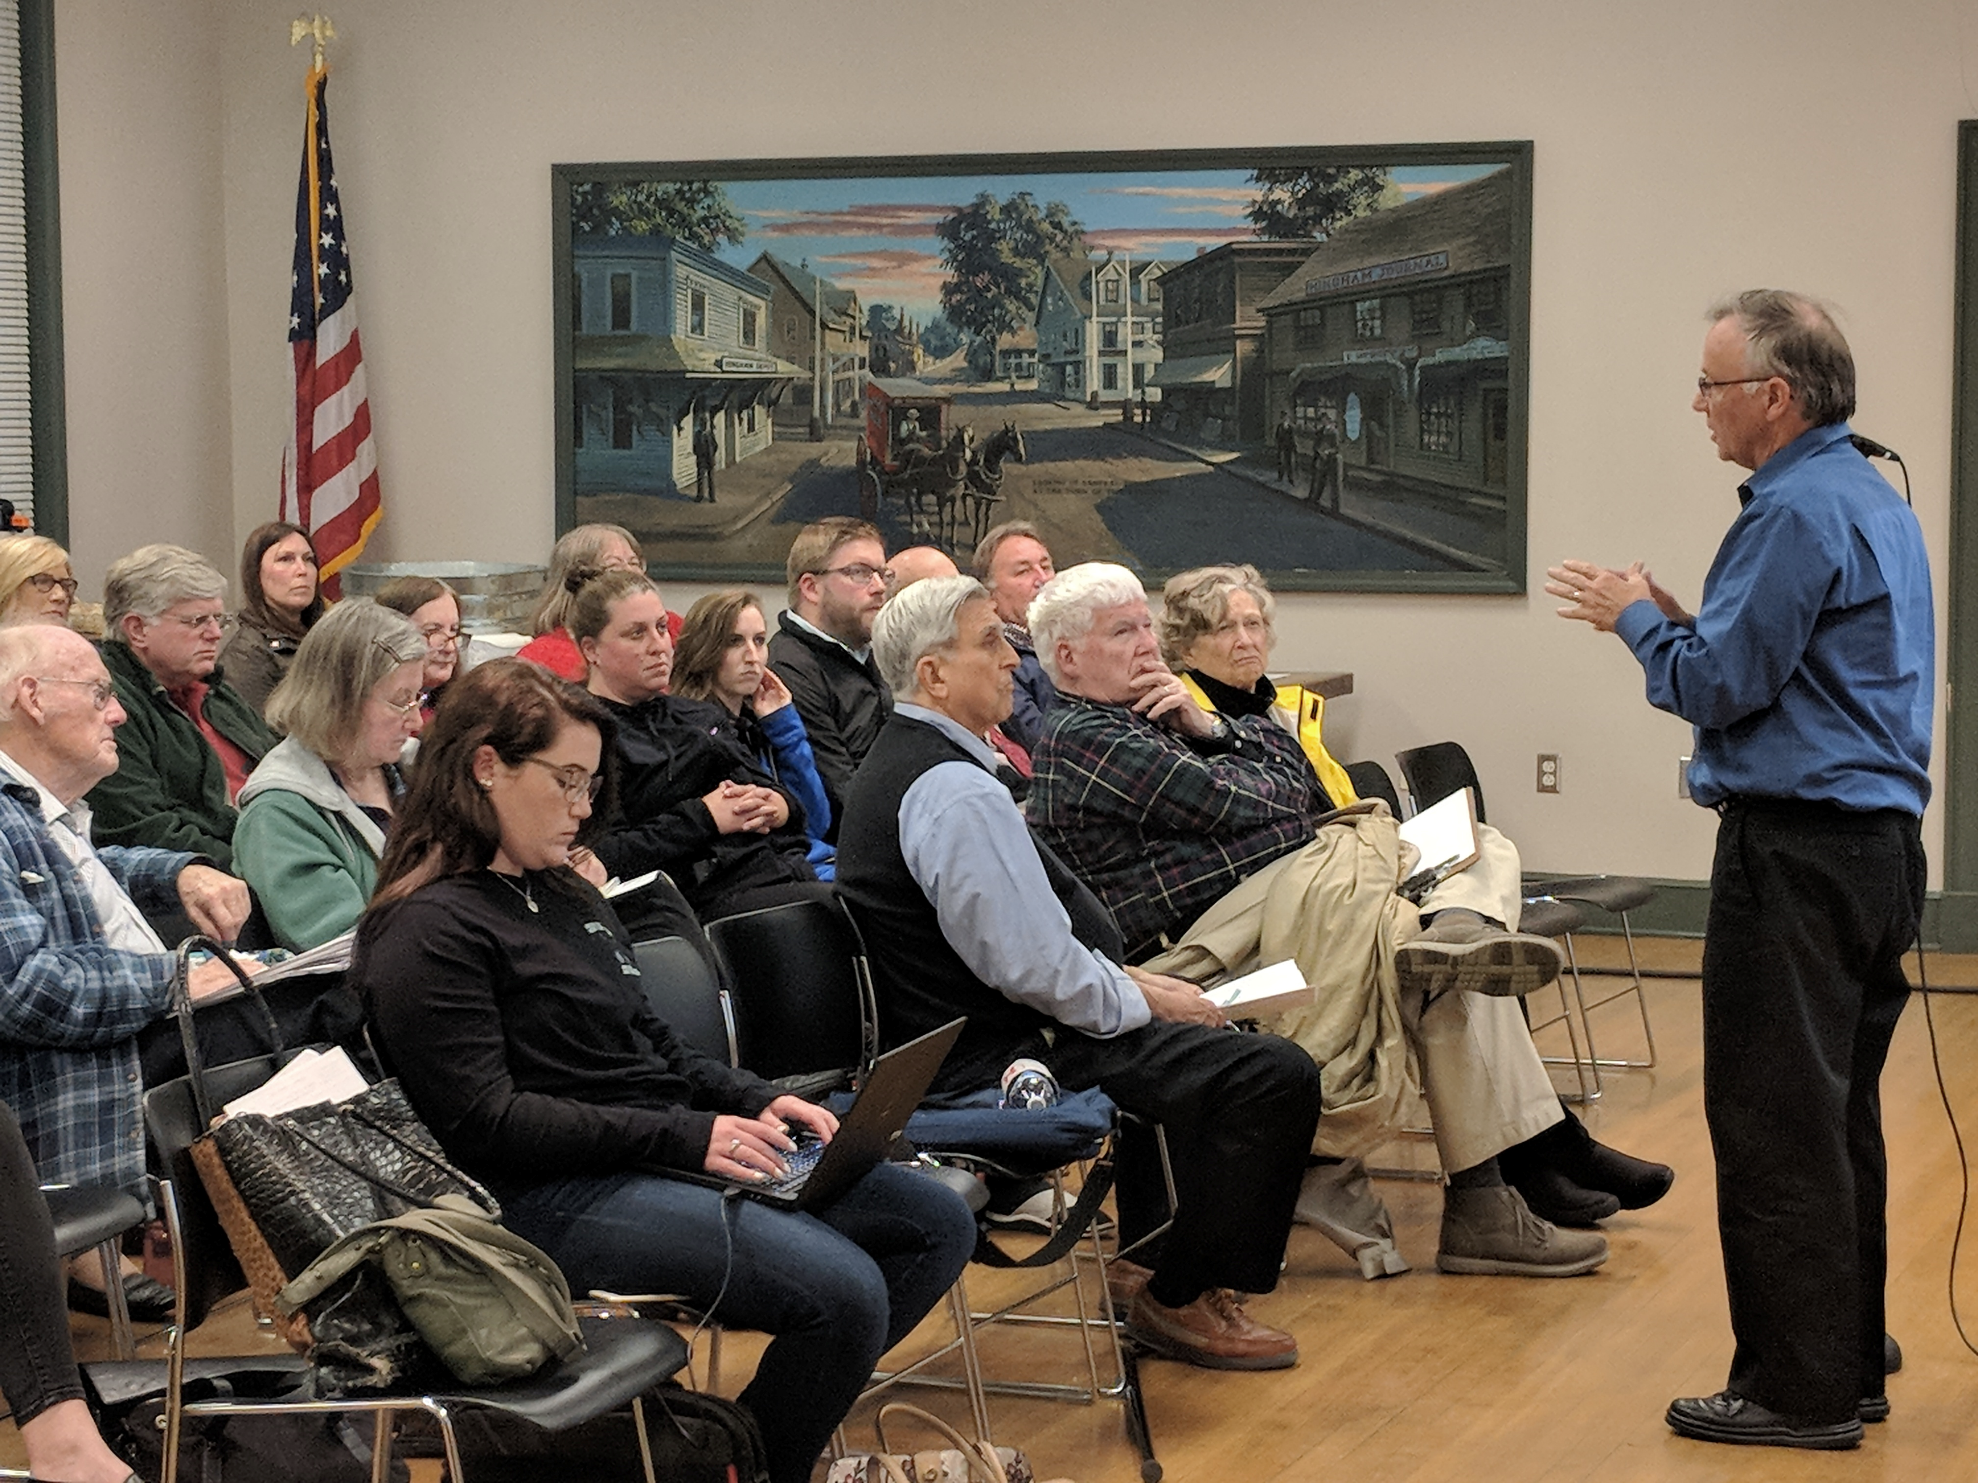
What other strategies should we consider?
Sources include:
Previous plans and studies
Housing Needs Assessment
Interviews
Meetings including Community Housing Forum on May 15th
Effective strategies in Hingham and other communities
Targeted goals
2019 Hingham Housing Plan

Slide 8

Capacity Building Strategies
Make community education a priority
Forums
Annual Summit
Public Access Television
Website
Training
Secure sustainable funding sources for Housing Trust
Community Preservation Act
Regional CPA Appropriations
Grants
Donations
Fundraising
2019 Hingham Housing Plan

Slide 9
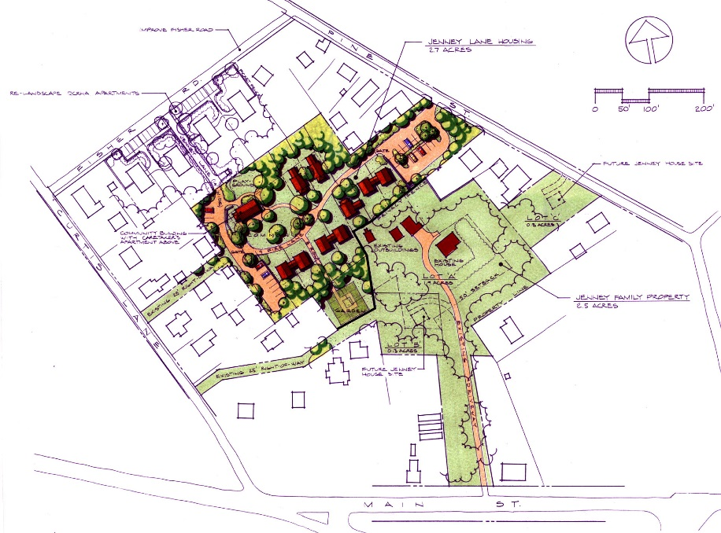
Zoning Strategies
Pursue greater housing diversity in more areas…
Expand
Accessory Dwelling Unit Zoning
Amend FRD
and
Mixed Use Zoning
Consider
Inclusionary Zoning
Address Teardown Activity
Explore Cottage Development
Jenney Way in Edgartown
2019 Hingham Housing Plan

Slide 10
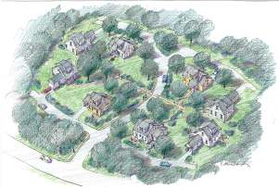
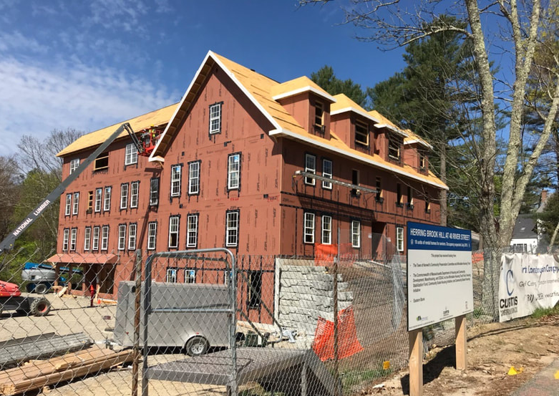
Housing Development Strategies
Craftsman Village
Public Property Options
Suitable Tax Title Properties
Lincoln School Expansion
Beal Street Opportunities
Newly Acquired Property
Herring Brook Hill in Norwell
Private Property Options
Areas with Available Infrastructure
Downtown
Infill Opportunities
South Hingham
2019 Hingham Housing Plan
Notes:
Make suitable public property available for affordable housing
Responsible Parties: BOS/HAHT and Town Meeting
Partner with Private Developers on Privately-Owned Properties

Slide 11

Preservation Strategies
Consider Adaptive Reuse Opportunities
Monitor Compliance with Affordability Requirements
Introduce a Small Grant Repair Program
Connect Qualifying Residents to Other Housing Rehabilitation Initiatives
2019 Hingham Housing Plan

Slide 12
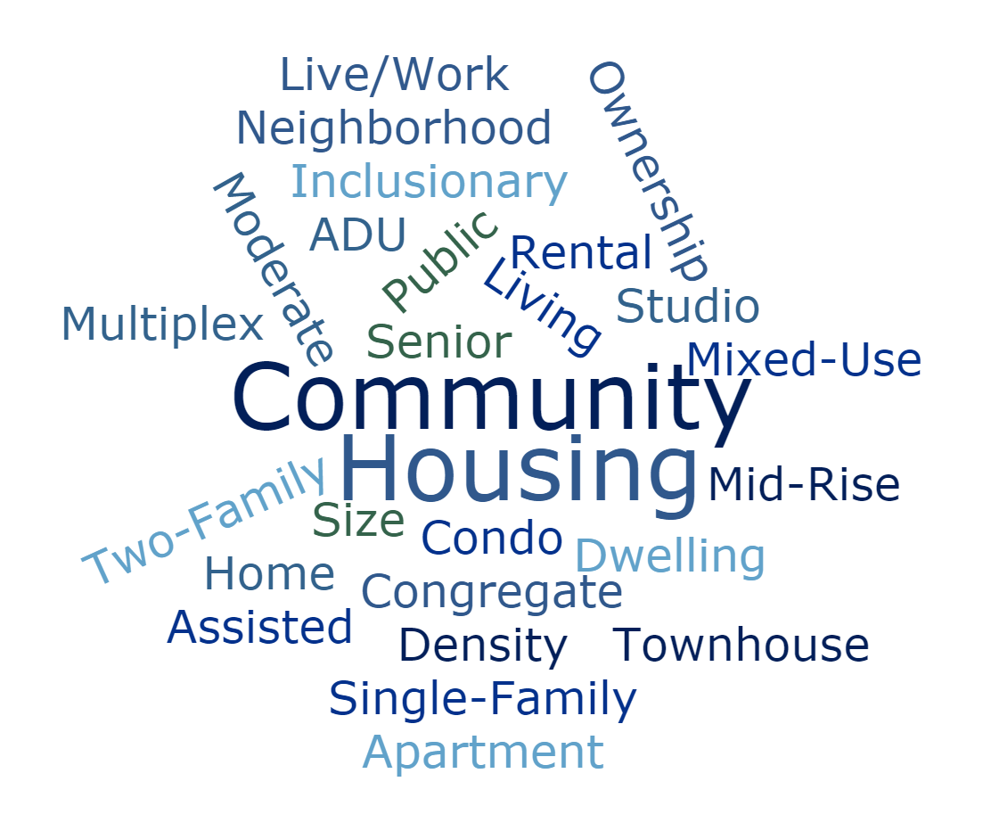
What do you think?
Your questions and comments tonight will help the project team finalize the housing goals and strategies…
2019 Hingham Housing Plan

